Slide 1


Maithri Amarnath Vijayakumari
14/4/2024

Slide 2

Outline
Executive Summary
Introduction
Methodology
Results
Conclusion
Appendix

Slide 3
Executive Summary
Summary of methodologies
Data Collection using SpaceX API and Web scraping.
Perform data wrangling using Pandas.
Exploratory Data Analysis using SQL and Data Visualization.
Interactive Visualization Folium and Dash.
Machine Learning Model Building and Prediction
Summary of all results
Exploratory Data Analysis results presented using Visualization.
Interactive Visualization and Dashboard.
Predictive Analysis(Classification)

Slide 4
Introduction
Project background and context
SpaceX advertises Falcon 9 rocket launches on its website, with a cost of 62 million dollars; other providers cost upward of 165 million dollars each, much of the savings is because SpaceX can reuse the first stage. Therefore if we can determine if the first stage will land, we can determine the cost of a launch. This information can be used if an alternate company wants to bid against SpaceX for a rocket launch. In this project we will determine what is the likelihood that SpaceX reuse the first stage by training a machine learning model. And determine what factors are used to predict if the first stage will land successfully.
Problems you want to find answers
In this project we will determine what is the likelihood that SpaceX reuse the first stage by training a machine learning model. And determine what factors are used to predict if the first stage will land successfully.

Slide 5

Section 1

Slide 6
Methodology
Executive Summary
Data collection methodology:
Collecting SpaceX data by using SpaceX API and Web scrapping
Perform data wrangling
Exploratory Data Analysis (EDA) to find some patterns in the data and determine what would be the label for training supervised models.
Perform exploratory data analysis (EDA) using visualization and SQL
Perform interactive visual analytics using Folium and Plotly Dash
Perform predictive analysis using classification models
By Standardize the data Split into training data and test data we find best Hyperparameter for SVM, Classification Trees and Logistic Regression and also find the method that performs best using test data

Slide 7
Data Collection
Data collection is process of gathering and measuring information on targeted variables in an established system, which then enables one to answer relevant questions and evaluate outcome.
For this project the data was collected by REST API and web scrapping from Wikipedia.
Use Space X API
Returns spaceX data in .JSON format
Normalize the data into .csv format
Data is ready for data Wrangling
Use Beautiful Soup to extract data in HTML format
Parse the table and convert it into pandas data frame
Normalize the data into .csv format

Slide 8
Data Collection – SpaceX API
Data collection with SpaceX REST API
GitHub URL:
https://github.com/my3amarnath/SpaceX-Falcon-9-first-stage-Landing-Prediction/blob/main/SpaceX-%20Collecting%20the%20data.ipynb
Requested and parsed the SpaceX launch data using the GET request
Used json_normalize method to convert Json data into dataframe
Filtered the dataframe to only include Falcon 9 launches
Preformed data cleaning and handled the missing values

Slide 9
Data Collection - Scraping
Web Scrapping from Wikipedia
GitHub URL:
https://github.com/my3amarnath/SpaceX-Falcon-9-first-stage-Landing-Prediction/blob/main/Web%20scraping%20Falcon%209%20and%20Falcon%20Heavy%20Launches%20Records%20from%20Wikipedia.ipynb
Requested the Falcon9 Launch Wiki page from its URL
Created a BeautifulSoup from the HTML response
Extract all column/variable names from the HTML table header
Create a data frame by parsing the launch HTML tables

Slide 10
Data Wrangling
Data Wrangling is process of cleaning and unifying messy and complex data sets for easy access and EDA.
The launch sites, orbit types and mission outcomes were cleaned up.
The handful of mission outcomes were converted into a binary classification where 1 refers to Falcon 9 first stage landing was a success and 0 indicates it was failure.
GitHub URL:
https://github.com/my3amarnath/SpaceX-Falcon-9-first-stage-Landing-Prediction/blob/main/Data%20wrangling.ipynb
Check null values
Calculated the number of launches on each site
Calculated the number and occurrence of each orbit.
Calculated the number and occurrence of mission outcome of the orbits
Created a landing outcome label from Outcome column
Handle null values

Slide 11
EDA with Data Visualization
We used scatter plot and bar chart to find the relationship between different attributes as below.
Use scatter plot to visualize the relationship between Flight Number and Launch Site.
Use scatter plot to visualize the relationship between Payload and Launch Site.
Use bar chart to visualize the relationship between success rate of each orbit type.
Use scatter plot to visualize the relationship between Flight Number and Orbit type.
Use line plot to visualize the launch success yearly trend.
Once a pattern is determined through visualization it would be easy to understand the factors affecting the success rate of Falcon 9 landing.
GitHub URL: https://github.com/my3amarnath/SpaceX-Falcon-9-first-stage-Landing-Prediction/blob/main/Exploratory%20Data%20Analysis(EDA)%20with%20Visualization%20and%20Preparing%20Data.ipynb

Slide 12
EDA with SQL
Using SQL, we had performed many queries to understand the dataset as below.
Display the names of the unique launch sites in the space mission.
Display 5 records where launch sites begin with the string 'CCA’.
Display the total payload mass carried by boosters launched by NASA (CRS).
Display average payload mass carried by booster version F9 v1.1.
List the date when the first successful landing outcome in ground pad was achieved.
List the names of the boosters which have success in drone ship and have payload mass greater than 4000 but less than 6000.
List the names of the booster versions which have carried the maximum payload mass. Use a subquery
List the records which will display the month names, failure landing outcomes in drone ship ,booster versions, launch site for the months in year 2015.
Rank the count of landing outcomes (such as Failure (drone ship) or Success (ground pad)) between the date 2010-06-04 and 2017-03-20, in descending order.
GitHub URL : https://github.com/my3amarnath/SpaceX-Falcon-9-first-stage-Landing-Prediction/blob/main/Exploratory%20Data%20Analysis(EDA)%20with%20SQL.ipynb

Slide 13
Build an Interactive Map with Folium
Markers were added for launch sites and for NASA Johnson Space Center.
Circles were added for the launch sites with thecolor-labeled markers in marker clusters, you should be able to easily identify which launch sites have relatively high success rates.
Lines were added to explore and analyze the proximities of launch sites..
Are launch sites in close proximity to railways?.
Do launch sites keep certain distance away from cities?
Are launch sites in close proximity to highways?
Are launch sites in close proximity to coastline?
GitHub URL: https://github.com/my3amarnath/SpaceX-Falcon-9-first-stage-Landing-Prediction/blob/main/Launch%20Sites%20Locations%20Analysis%20with%20Folium.ipynb

Slide 14
Build a Dashboard with Plotly Dash
Summarize dashboard
Dashboard was built with Plotly Dash which would allow users to derive and visualize the results they want.
Plotted Pie charts showing the outcome of launches for all sites and can be filtered based on launch sites by using the drop down menu.
Plotted Scatter graph showing the relationship between the outcome of launches and Payload Mass for different booster versions by using Slider to select the payload range.
GitHub URL: https://github.com/my3amarnath/SpaceX-Falcon-9-first-stage-Landing-Prediction/blob/main/SpaceX_Launch_Records_Dashboard.py

Slide 15
Predictive Analysis (Classification)
The data set was split into training and testing set.
Logistic regression, SVM (Support Vector Machine), Decision Tree and KNN (K-Nearest Neighbor) machine learning models were trained used training test.
Hyper-parameters were evaluated using GridSearchCV() and the best was selected using best_params_.
Using best hyper parameters, each of the four models were scored on accuracy using testing set.
GitHub URL: https://github.com/my3amarnath/SpaceX-Falcon-9-first-stage-Landing-Prediction/blob/main/SpaceX%20Machine%20Learning%20Prediction.ipynb
Dataframe was created with cleaned data
Data was split into training and testing sets
Each of the four models were trained using training set
Each of the four models were evaluated on test data
Models were compared based on the accuracy score.

Slide 16
Results
Exploratory data analysis results
Interactive analytics demo in screenshots
Predictive analysis results

Slide 17

Section 2

Slide 18
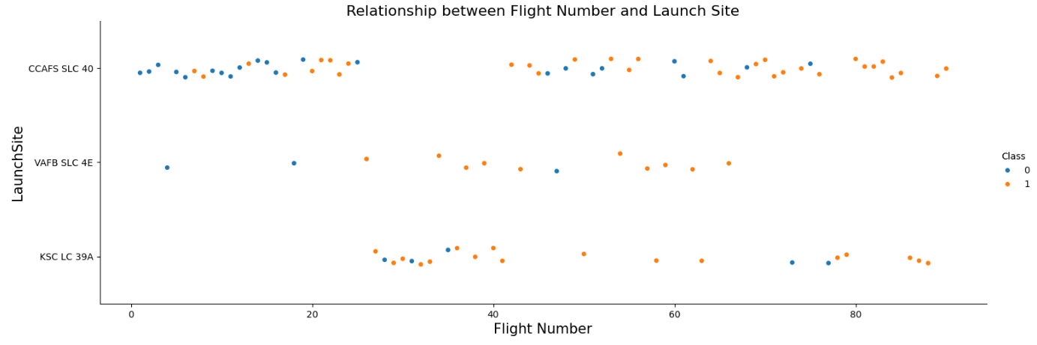
Flight Number vs. Launch Site
Scatter plot of Flight Number vs. Launch Site
Launch site CCAFS SLC 40 has the most number of launches.
Class 0 (Failed) is often found at early flight numbers

Slide 19
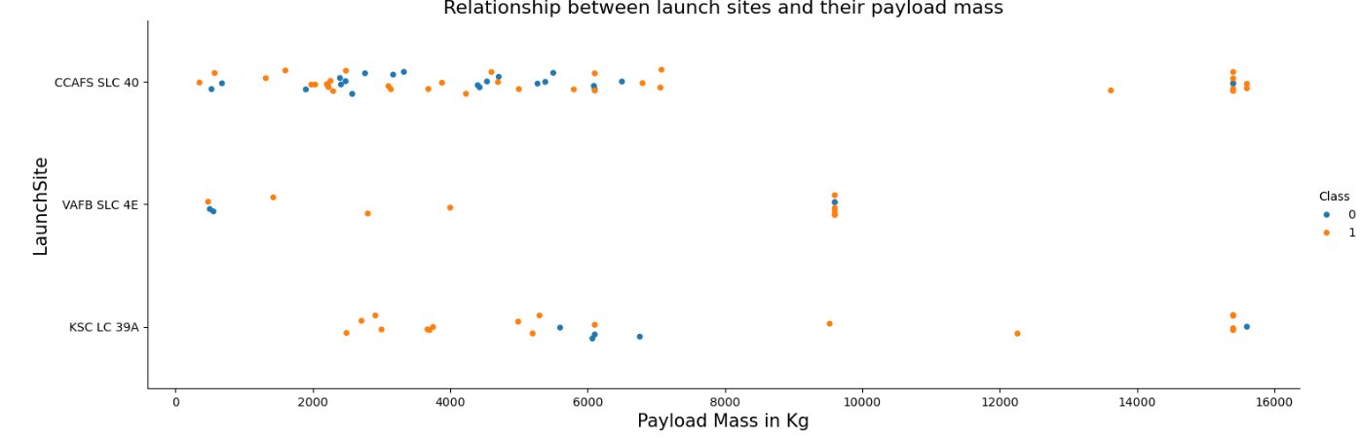
Payload vs. Launch Site
Scatter plot of Payload vs. Launch Site
Launch site VAFB SLC 4E don’t have launch that have payload mass more than 10,000kg

Slide 20
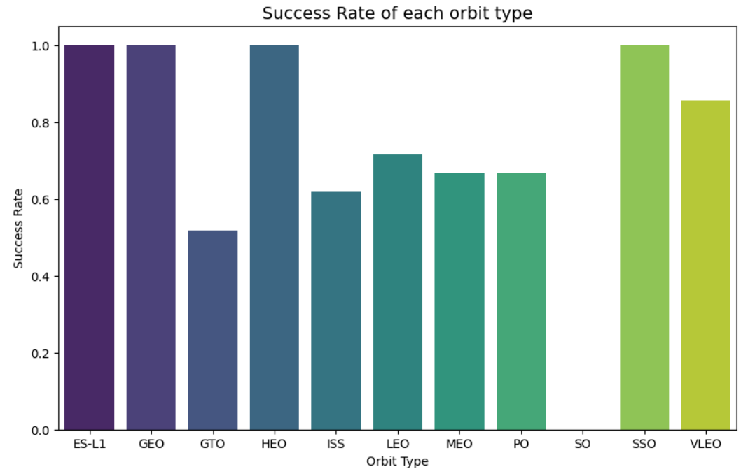
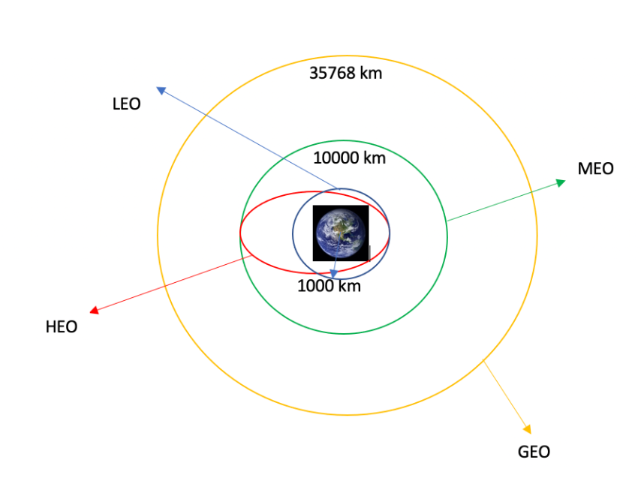
Success Rate vs. Orbit Type
Bar chart for the success rate of each orbit type
Orbit ES-L1, GEO, HEO, SSO have the best success rate. Orbit SO have no successful first stage landing.

Slide 21
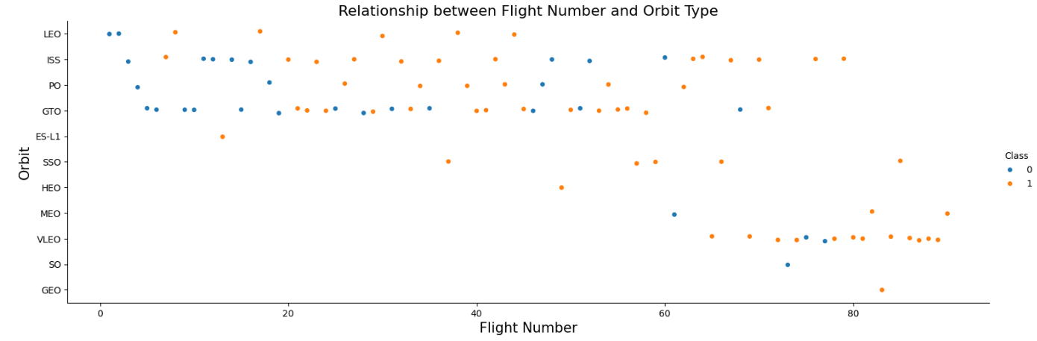
Flight Number vs. Orbit Type
Scatter point of Flight number vs. Orbit type
Orbits MEO, VLEO, SO and GEO are found at flight number 60 and 80.

Slide 22
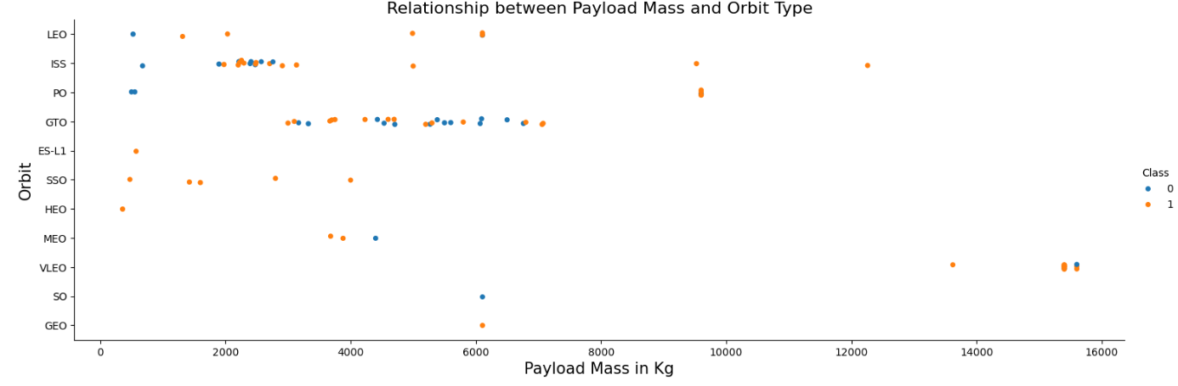
Payload vs. Orbit Type
Scatter point of payload vs. orbit type
Some orbits have better success rate than others.
Orbit GTO and has higher success rate with payload mass between 2500kg to 6500kg.
While Orbit ISS has few success rates with payload mass ranging from 2000kg to 3500kg.

Slide 23
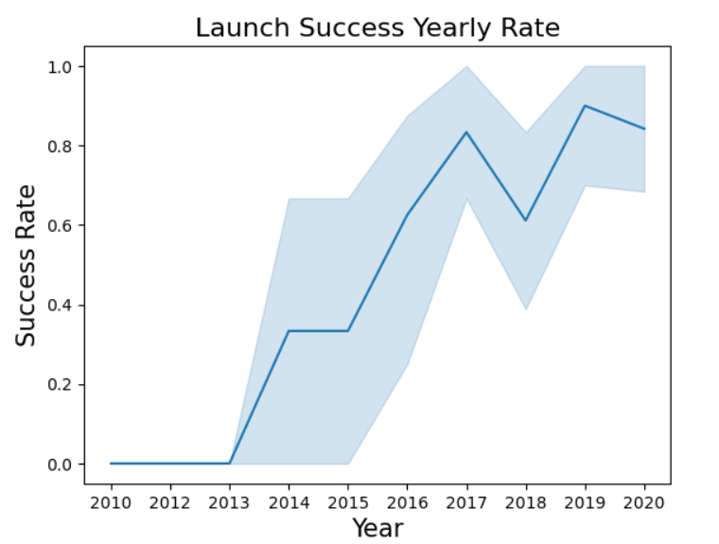
Launch Success Yearly Trend
Line chart of yearly average success rate
The success rate of first stage landing has significantly increased over years.
In year 2018 success rate was decreased to 60% from 80% in 2017 but was subsequently increased back to 80% in 2019.

Slide 24
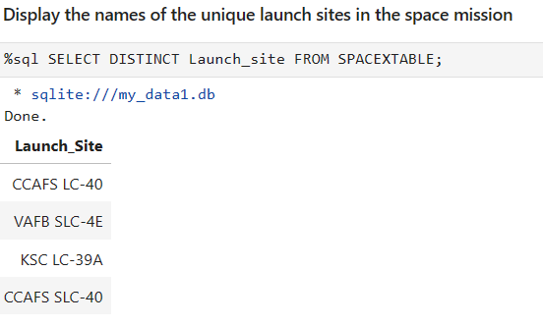
All Launch Site Names
Names of the unique launch sites
There are four unique launch sites as seen from the results

Slide 25
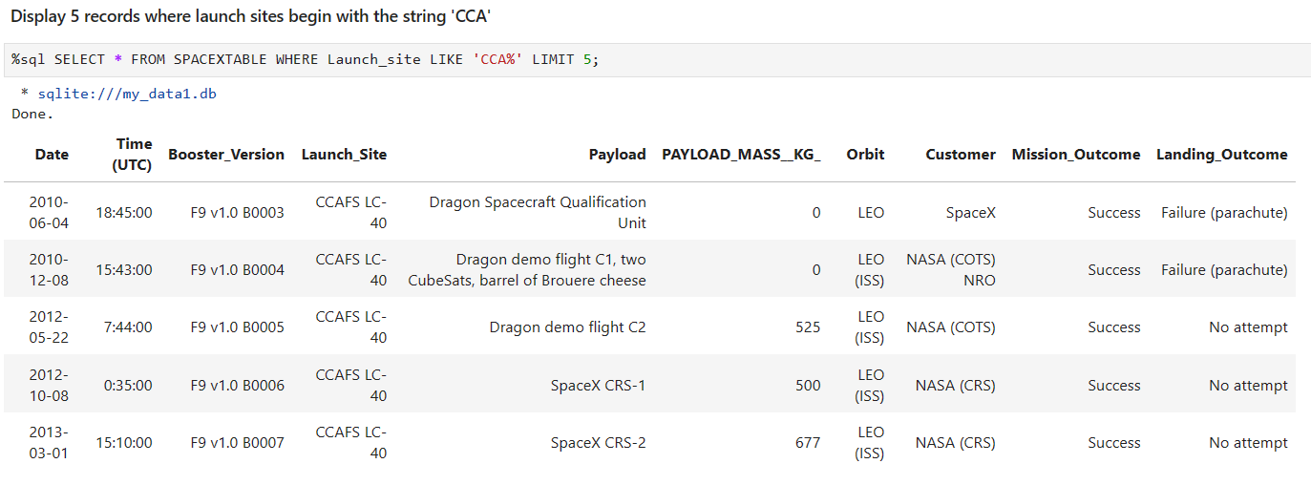
Launch Site Names Begin with 'CCA'

Slide 26
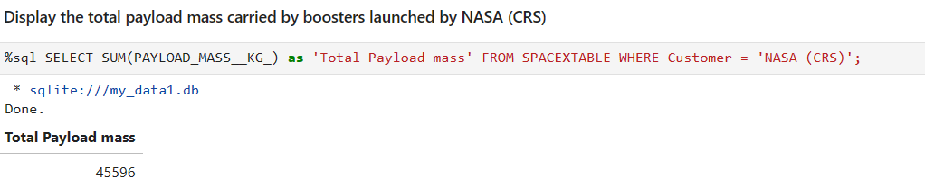
Total Payload Mass
The total payload carried by NASA (CRS) is 45,596 kg.

Slide 27
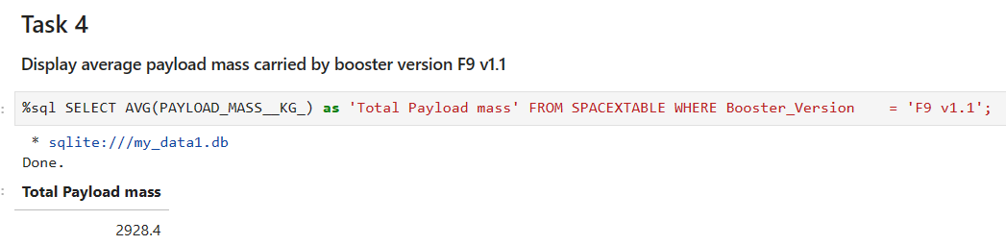
Average Payload Mass by F9 v1.1
The average payload mass carried by booster version F9 v1.1 is 2928 kg.

Slide 28
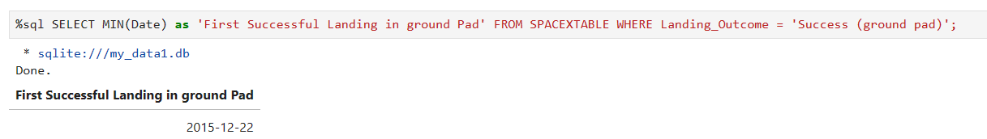
First Successful Ground Landing Date
The dates of the first successful landing outcome on ground pad was on
December 22, 2015.

Slide 29
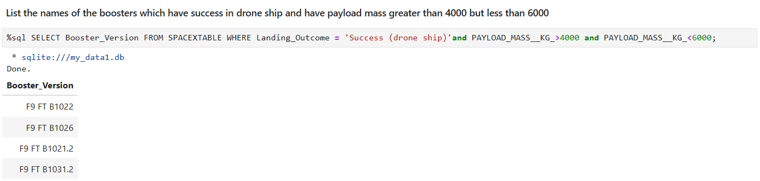
Successful Drone Ship Landing with Payload between 4000 and 6000
Four of boosters have successfully landed on drone ship and had payload mass greater than 4000 but less than 6000 and the names are as below.

Slide 30
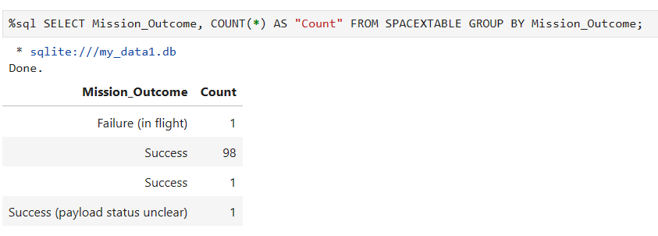
Total Number of Successful and Failure Mission Outcomes
The total number of successful and failure mission outcomes are as below.
We have 1 failure mission outcome and 100 successful ones.

Slide 31
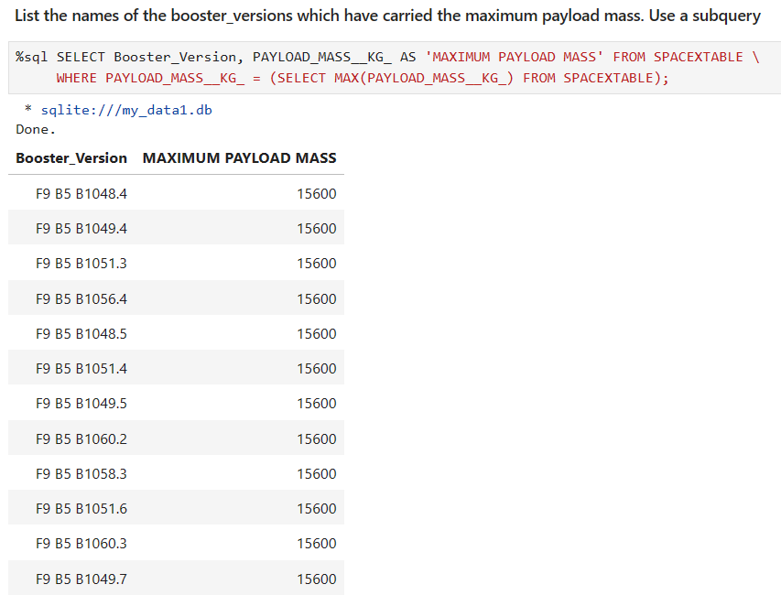
Boosters Carried Maximum Payload
The names of the booster which have carried the maximum payload mass are as below

Slide 32
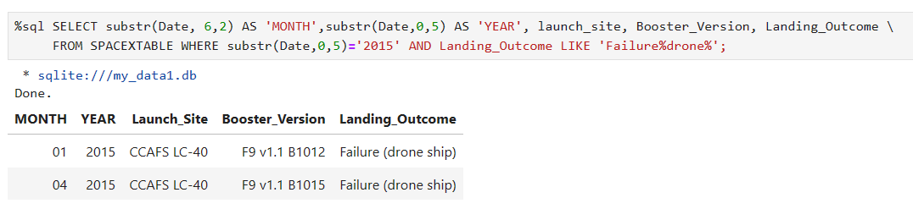
2015 Launch Records
The failed landing outcomes in drone ship, their booster versions, and launch site names for in year 2015
There were 2 failed landing outcomes with drone ship in 2015. Both were launched from CCAFS LC-40. One was in January and the other was in April.

Slide 33
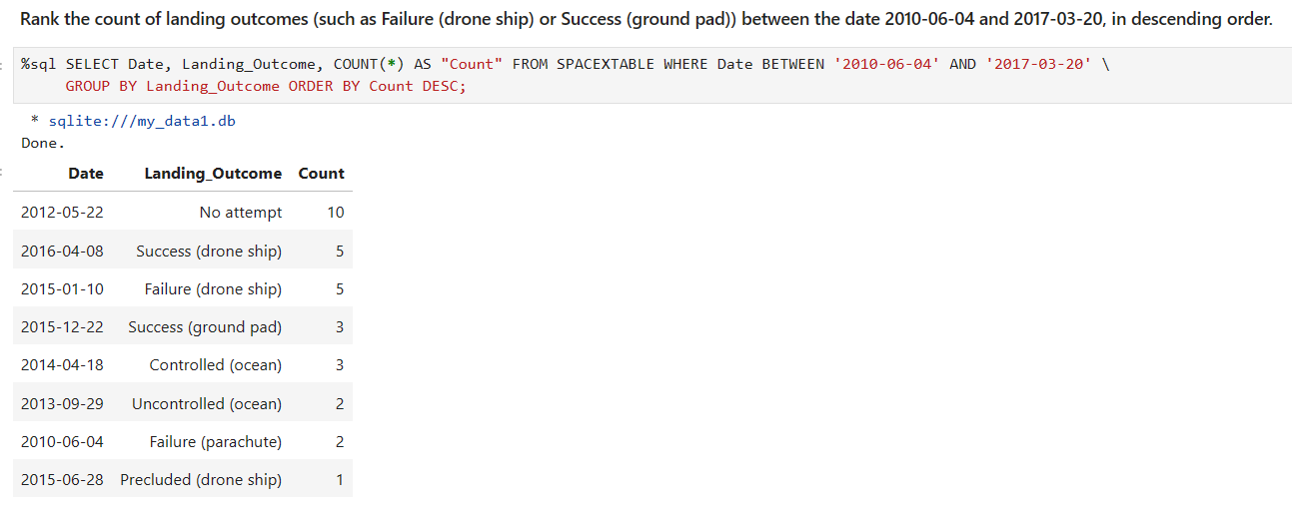
Rank Landing Outcomes Between 2010-06-04 and 2017-03-20
The count of landing outcomes (such as Failure (drone ship) or Success (ground pad)) between the date 2010-06-04 and 2017-03-20, in descending order.
The most common landing outcome was ‘No attempt’

Slide 34

Section 3

Slide 35
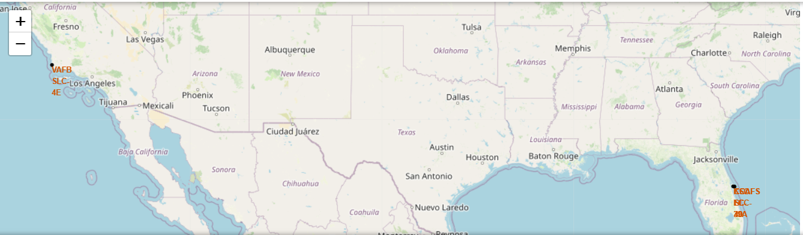
Falcon 9 Launch Site Locations
VAFB SLC-4E(California, USA) : Vandenberg Air Force Base Space Launch Complex 4E.
KSC LC-39A(Florida, USA) : Kennedy Space Center Launch Complex 39A.
CCAFS LC-40(Florida, USA) : Cape Canaveral Air Force Station Launch Complex 40.
CCAFS SLC-40(Florida, USA) : Cape Canaveral Air Force Station Space Launch Complex 40.

Slide 36
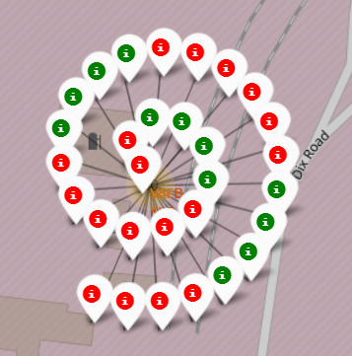
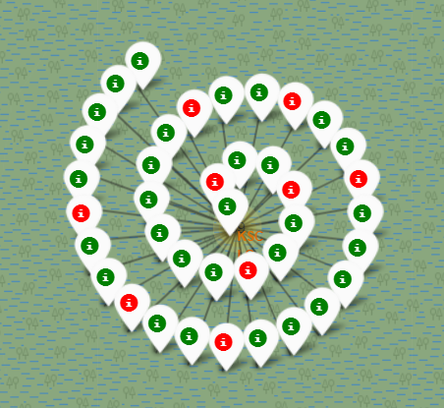
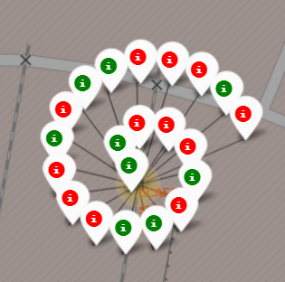
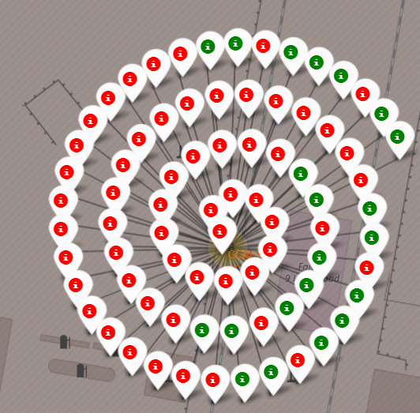
Marker of Success/Failure Landing in Launch Sites
The marker display the mission outcome for falcon 9 first stage landing. They are grouped on the map to be associated geographical coordinates for launch sites.
The success rate of a launch site for falcon 9 first stage landing can be viewed with a green marker were was the failure are the red ones
VAFB SLC-4E
KSC LC 39 A
CCAFS SLC-40
CCAFS LC-40

Slide 37
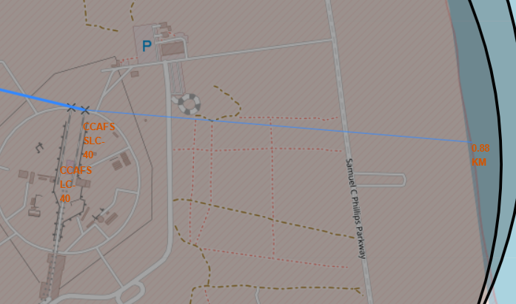
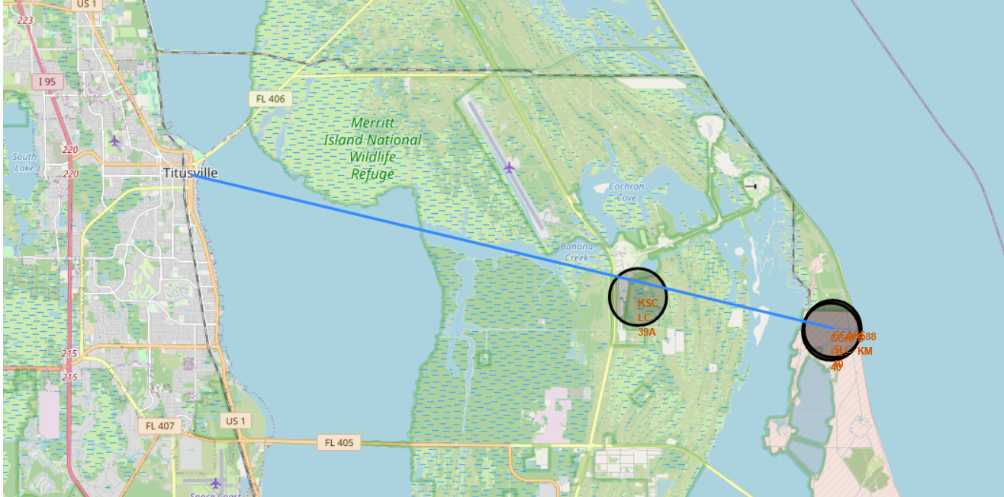
Distance between Launch Site to its Proximities
The CCAFS LC-40 and CCAFS SLC-40 launch sites have corradiated close to each other compared to rest other launch sites.
The coastline is around 0.88Km away from CCAFS SLC-40 launch site.
The nearest city Titusville was marked with line between launch site and the closest city.

Slide 38

Section 4

Slide 39
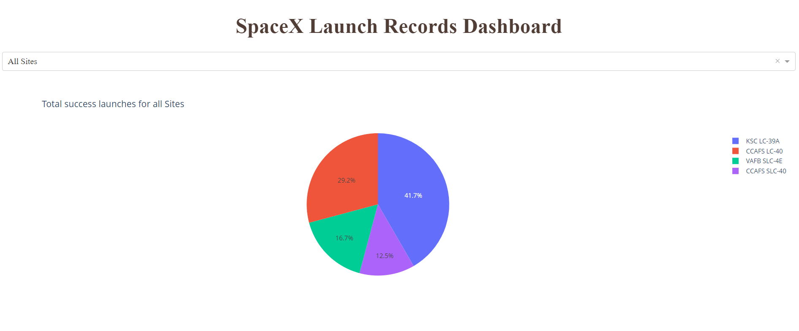
Success Percentage for all Launch Sites
Launch Site KSC LC-39A had greater success rate launches compared to others with 41.7%.
With only 12.5% success rate CCAFS SLC-40 launch site has the lowest success rate launches compared to others.

Slide 40
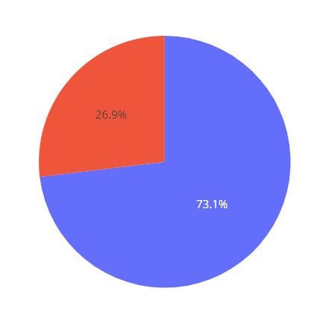
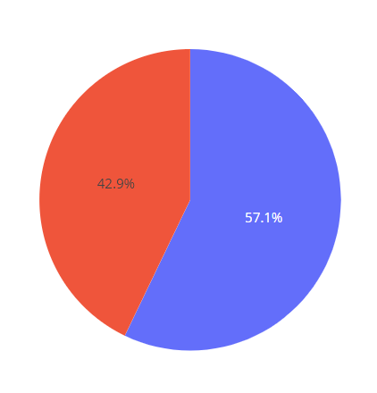
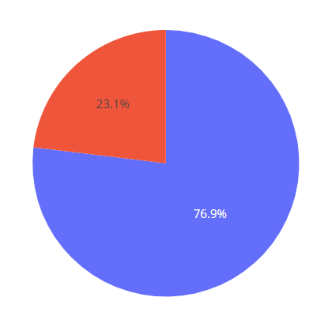
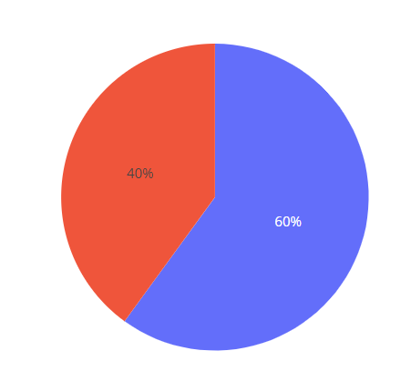
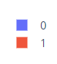
Launch Success Ratio for All Sites
KSC LC-39A launch site has the highest failure rate of 76.9% whereas CAFS SLC-40 has the highest sucesss rate of 42.9%
CCAFS LC-40
CCAFS SLC-40
KSC LC-39A
VAFB SLC-4E
0 : Failure
1: Success

Slide 41
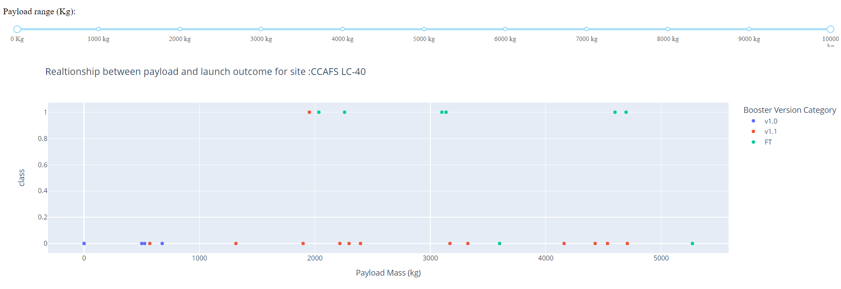
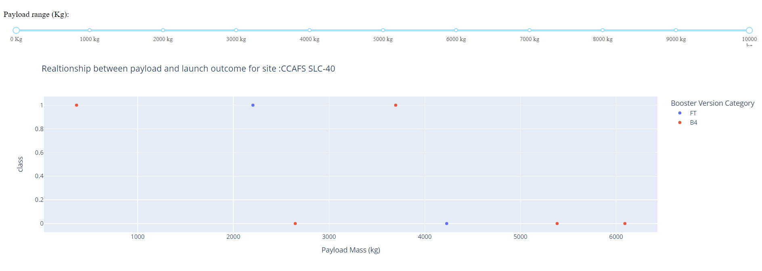
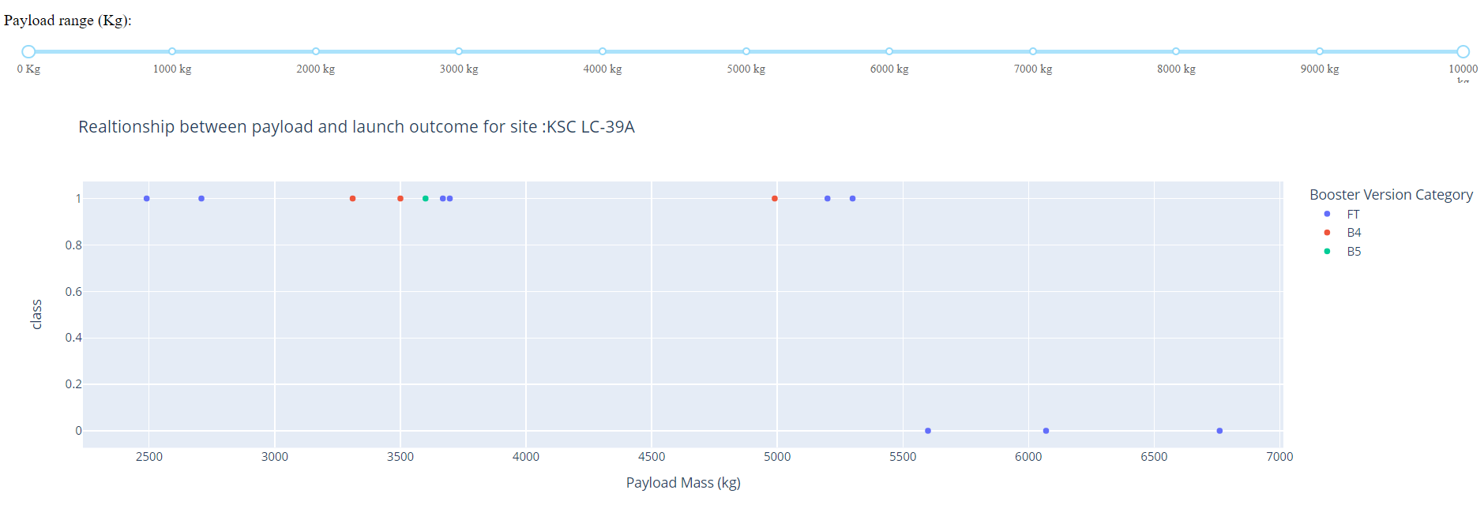
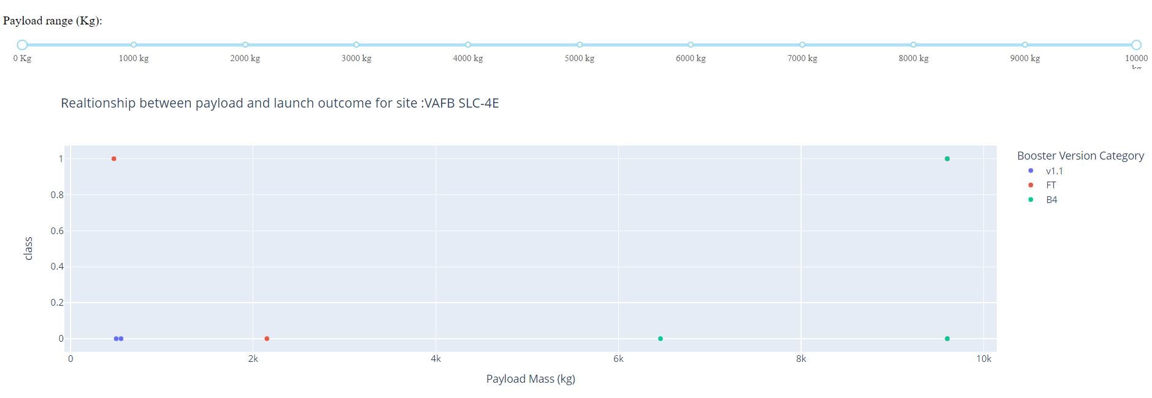
Payload vs Launch Site Outcome with Booster Versions
The payload range from about 2000kg to 5000kg has the largest success rate.
And the FT booster version has the highest success rate.

Slide 42

Section 5

Slide 43
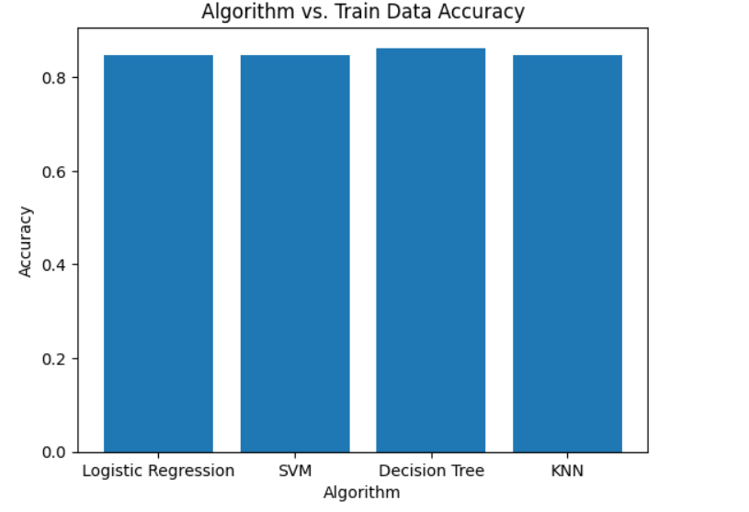
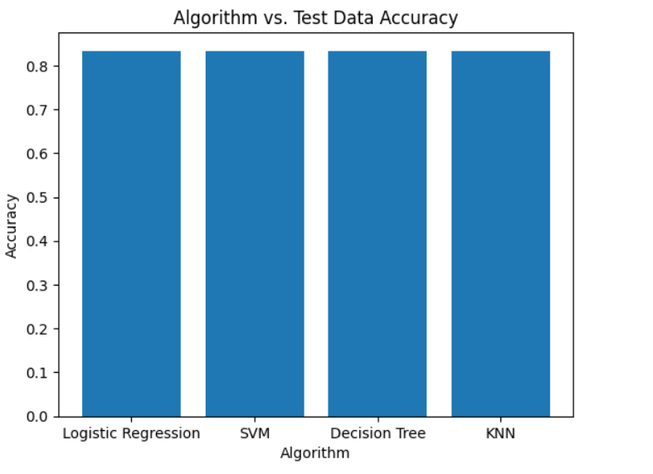
Classification Accuracy
Best Algorithm with training data is Decision Tree with a score of 0.8625.
Whereas ss per above Accuracy chart for test data -
All methods perform equally on the test data and they all have same accuracy of 0.833333 on the test Data.

Slide 44
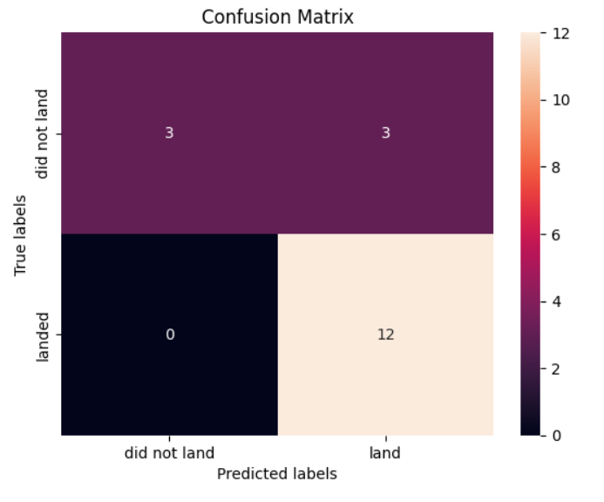
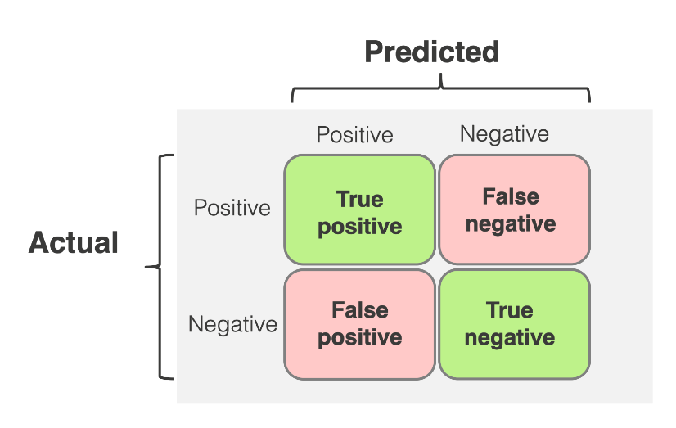
Confusion Matrix
The chart shown is the confusion matrix for Decision Tree.
Confusion matrix can be read as
Prediction Breakdown:
12 True Positives and 3 True Negatives
3 False Positives and 0 False Negatives

Slide 45
Conclusions
The SVM, KNN, Decision Tree and Logistic regression models are the best models in terms of prediction accuracy of the dataset.
KSC LC-39A has the most successful launches compared to all sites.
Orbit GEO, HEO, SSO, ES L1 has the best success rate.
Low weighted payloads have higher success landing rate than the heavier load.
SpaceX doesn’t have a perfect track record of Falcon9 first stage landing outcomes.
SpaceX Falcon9 first stage landing outcomes have been trending towards greater success over the last few years.
The machine learning model can be used to predict the future SpaceX falcon9 first stage landing outcome.

Slide 46
Appendix
GitHub URL : https://github.com/my3amarnath/SpaceX-Falcon-9-first-stage-Landing-Prediction/tree/main
Data Sets:
Wikipedia: "https://en.wikipedia.org/w/index.php?title=List_of_Falcon_9_and_Falcon_Heavy_launches&oldid=1027686922“
SpaceX JSON:
'https://cf-courses-data.s3.us.cloud-object-storage.appdomain.cloud/IBM-DS0321EN-SkillsNetwork/datasets/API_call_spacex_api.json’

Slide 47


